Slide 1
Frontend Development

Slide 2

An unvisited link is underlined and blue
A visited link is underlined and purple
An active link is underlined and red
a - Anchor
The most important attribute of the <a> element is the href attribute, which indicates the link's destination.

Slide 3
Attributes of a tag
href
Create a website link
<a href=” https://www.facebook.com//”>Facebook</a>
Create an email link
<a href=”mailto:info@xyz.com”>info@xyz.com</a>
Create a Phone Number link
<a href=”tel:02234558425”>022 34558425</a>

Slide 4
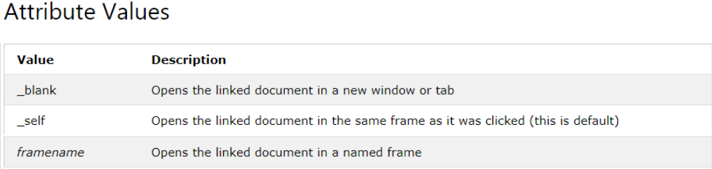
Attributes of a tag
target
Example how to use target attribute.
<a href=”https://codegirls.consulnet.net/” target=”_blank”>Code Girls</a>

Slide 5
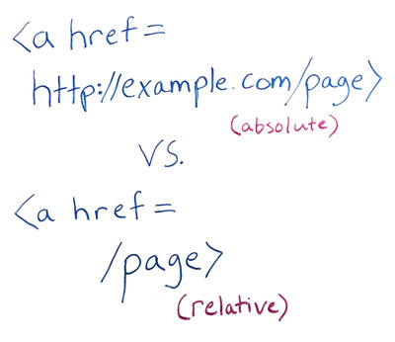
Absolute vs relative URLs
Absolute =
Relative =

Slide 6

Assignment
Create a clickable list of multiple social media websites at least 5 and open it to new tab.

Slide 7
References
https://developer.mozilla.org/en-US/docs/Web/HTML/Element/a
https://developer.mozilla.org/en-US/docs/Learn/Getting_started_with_the_web/Dealing_with_files

Slide 8
